Slide 1
What is Ursa?

Slide 2
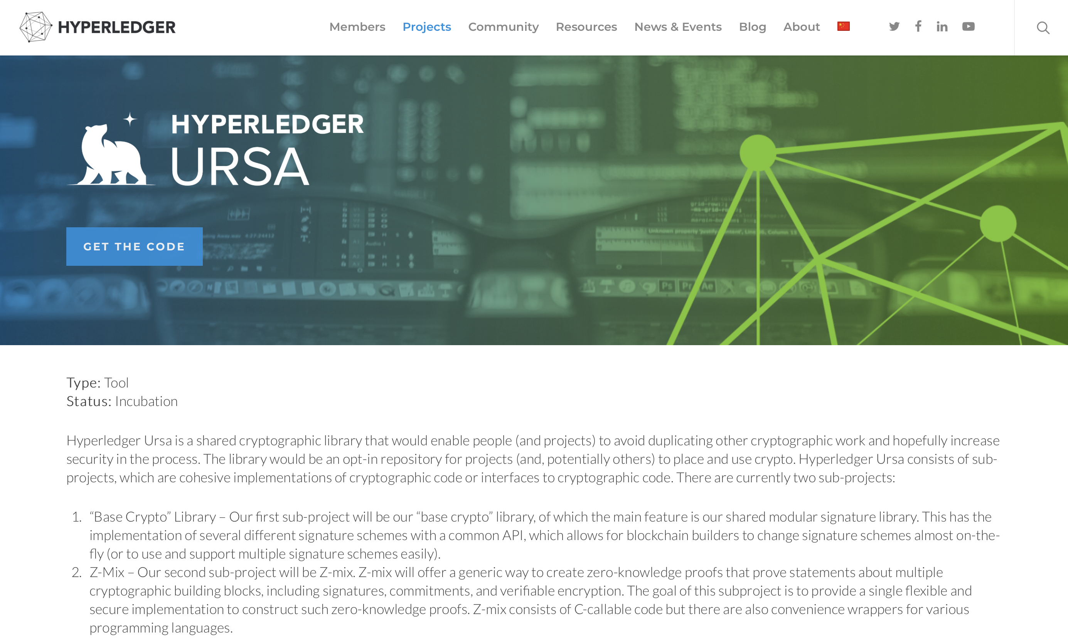

Slide 3
“
Hyperledger Ursa is a shared cryptographic library that would enable people (and projects) to avoid duplicating other cryptographic work and hopefully increase security in the process. The library would be an opt-in repository for projects (and, potentially others) to place and use crypto.
”

Slide 4
Hyperledger Ursa is a shared crypto library that provides Hyperledger projects with safe interfaces to access high-quality implementations of cryptographic primitives and key management functions.
Put simply, Ursa brings high trust and security to users of Hyperledger Frameworks.

Slide 5
Why?
Note: monoculture is bad, but own crypto is worse…

Slide 6
What do we have today?
LibUrsa
Designed for cryptographic primitives like simple digital signatures, encryption schemes, and key exchange.
2 interfaces:
Cryptographer interface for power and composable crypto
Developer interface for safety and ease of integration
LibZmix
A generic way to create zero-knowledge proofs, proving statements about multiple cryptographic building blocks, containing signatures, commitments, and verifiable encryption.
Hyperledger Indy using Ursa already 🎉

Slide 7
What do we have today?
We DO NOT write the actual crypto (unless we really have to!)
We use other best-of breed implementations:
Libsodium
Openssl
Libsecp256k1 from bitcoin-core
…
We are architecting in support for 3rd party providers such as HSMs
libsodium
libzmix
Secure Enclaves
Key:
Indy
openssl
Current
libursa
secp256k1
Crypto hardware
Future
Provider…

Slide 8
Where are we going?
Technology advancements
HSM integration
Enclave integration
More algorithms and crypto
Frameworks integration
Indy – more
Fabric
Sawtooth Transition policy / priority TBD
Iroha
Non-framework integration
Aries (AnonCreds)

Slide 9
Who’s involved?
Among other highly valued contributors we have:
Hyperledger security staff
Identity security experts
Zero-knowledge proof experts
Cryptography experts
Crypto hardware experts
Key management experts
Strong governance structure around contributions
Depending on sensitivity
Depending on impact

Slide 10
Who’s involved?

Slide 11
Who’s involved?
PLEASE JOIN US!

Slide 12
Ways to collaborate
Use cases and requirements
Standards, RFCs
Reviews and feedback
Contributions*
*Conditions apply. Qualified applicants only ☺
OPEN

Slide 13
Thank you
 |  | Jon Geater CTO & Co-Founder jon.geater@jitsuin.com +44 7500 786537

